Slide 1
Informal and underground economy financing developments
Belma Čolaković, CBBiH
Sarajevo, November 15th 2018
CBBH Conference „The Future of Cash“

Slide 2
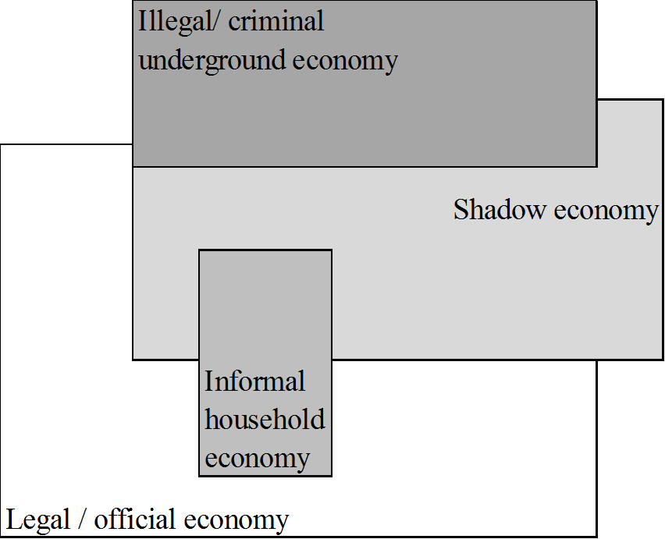
Types of economic activity
The figure is a replica of the one used by Friedrich Schneider.

Slide 3
Average informality weighted by total GDP in 2005
Region | Mean | Median | Min | Max | SD
East Asia and Pacific | 17.5 | 12.7 | 12.7 | 55.1 | 10.7
Europe and Central Asia | 36.5 | 32.8 | 18.2 | 66.7 | 8.6
Latin America and the Carribean | 34.7 | 33.7 | 19.3 | 66.1 | 8.0
Middle East and North Africa | 27.3 | 32.7 | 18.2 | 37.2 | 7.8
High Income OECD | 13.5 | 11.0 | 8.7 | 27.9 | 5.6
Other High Income | 20.8 | 19.5 | 12.4 | 33.4 | 4.8
South Asia | 25.1 | 22.2 | 22.2 | 43.7 | 5.9
Sub-Saharan Africa | 38.4 | 34.1 | 22.6 | 61.8 | 11.3
World | 17.2 | 13.4 | 8.7 | 66.7 | 9.7
Source: Schneider, F., Buehn, A. and Montenegro, C. E. (2010). Shadow Economies All Over the World: New Estimates for 162 Countries from 1999 to 2007. The World Bank Policy Research Working Paper No. 5356.

Slide 4
Why does it matter?
Apart from the obvious reason (taxation issues), underestimating GDP could result in inadequately formulated economic policies:
The short- and mid-term budgeting (and member contributions in the EU) is made with reference to the GDP
(Public) Debt to GDP ratio possibly overestimated
Chance that macroeconomic policies may be too expansionary and social policy too excessive
Widening income inequality as a consequence of clients failing to meet lending criteria

Slide 5
The main methods of measurement of the shadow economy
Methods based on the discrepancy between national expenditure and income statistics;
The physical input approach
Survey based measurement of discrepancies between the official and actual labour force
The currency demand approach
Most widely used in the literature
Series of known shortcomings

Slide 6
The currency demand approach
The starting Tanzi (1983) estimation is of the form:
where: C / M2 is the ratio of cash holdings to current and deposit accounts;
TW is a weighted average tax rate;
WS/Y is a proportion of wages and salaries in national income;
R is the interest paid on savings deposits, and;
Y/N is per capita income.
More recent papers address some of the shortcomings and adjust for changes in the financial system landscape. Ardizzi et al. (2011) also include the value of transactions settled by the e-payment.

Slide 7
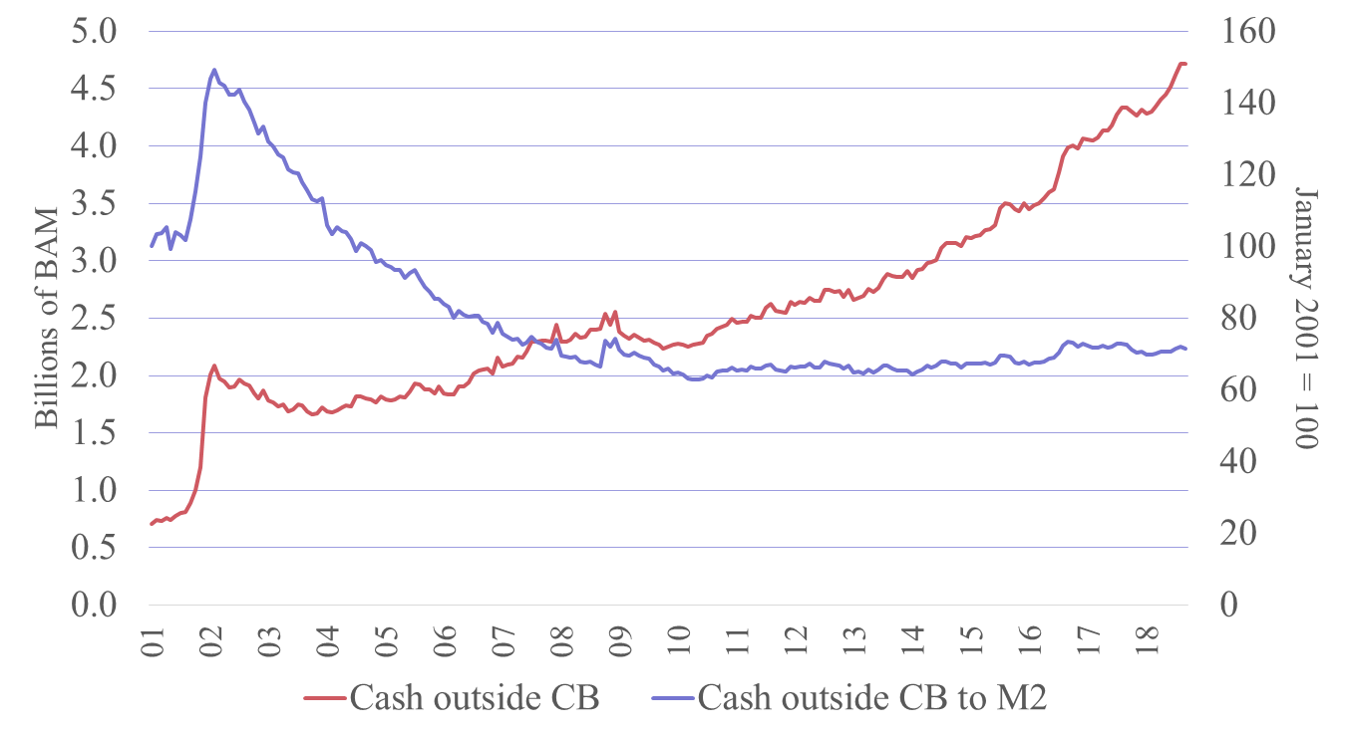
Currency demand in BH
Source: CBBH.

Slide 8
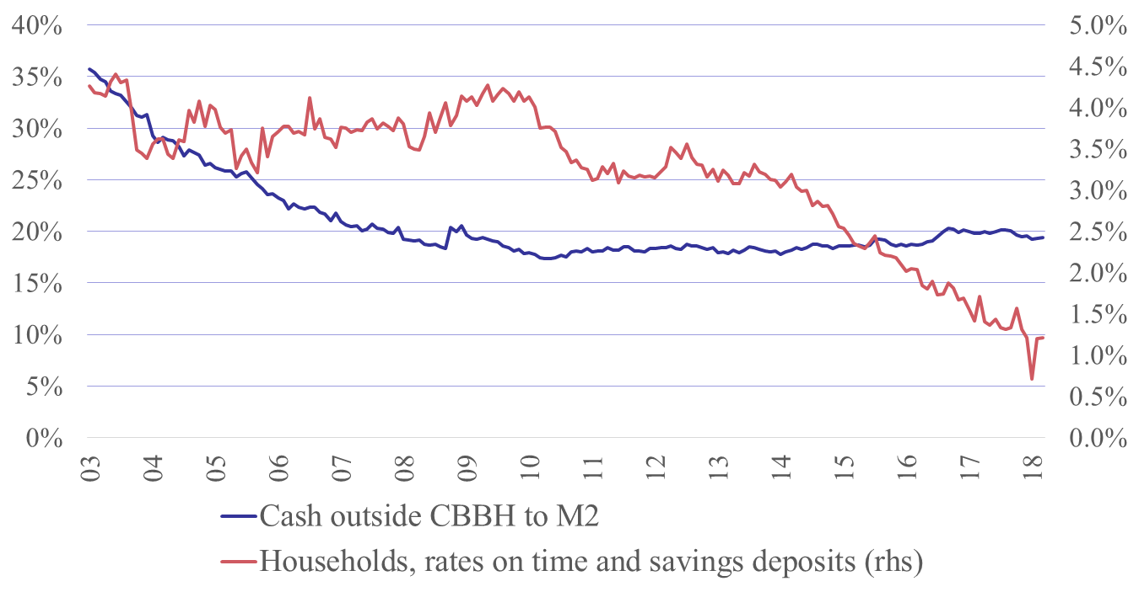
Currency demand in BH and interest rates
Source: CBBH, own calculations.

Slide 9
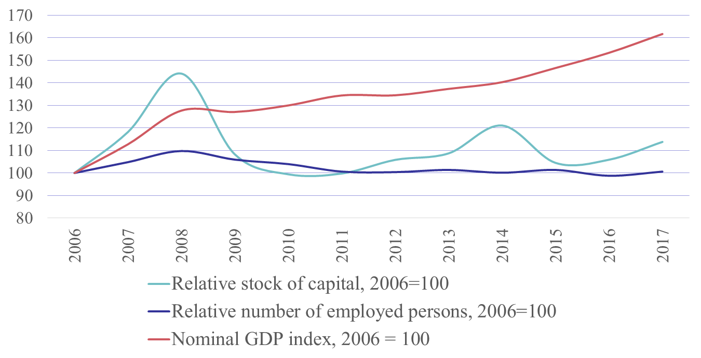
How severe is the issue of unregistered economy in BH?
Source: BHAS, own calculations

Slide 10
Thank you for your attention.

